Slide 1

Background
The company spends millions on sponsoring athletes to increase brand awareness. The company manually monitors videos and images where an athlete appears drinking the product (can-in-hand). This is deemed one of the most important KPIs to track brand spread. The client was interested in automating this process in order to reduce costs associated with the manual processing of these images.
Can-in-Hand Recognition through CNN
Developing State-of-the-Art Models to Automate Media KPIs
Our Solution
Given that there were no off-the-shelf Image Recognition APIs that have the can-in-hand detection feature, a classifier that automatically detects can-in-hand was developed. The detector (a faster regional Convolutional Neural Network) was trained on the company’s images and social media images drawing on techniques such as data augmentation and cloud GPU – based training. The model developed had an accuracy beyond 90% which was more than the minimum necessary to enable business decisions.
Value Delivered
The model developed has been incorporated to the online media monitoring tool at the CPG company to automatically provide the number of can-in-hand images that appear online from a list of domains. This allows for the replacement of external APIs by the self-trained model to save costs and gain ownership over the models.
Click Here for More Details
For further information and enquires, please contact:
Tomas Meca
tmecafigueras@deloitte.co.uk
Tobias Hess
tobhess@deloitte.de
1

Slide 2
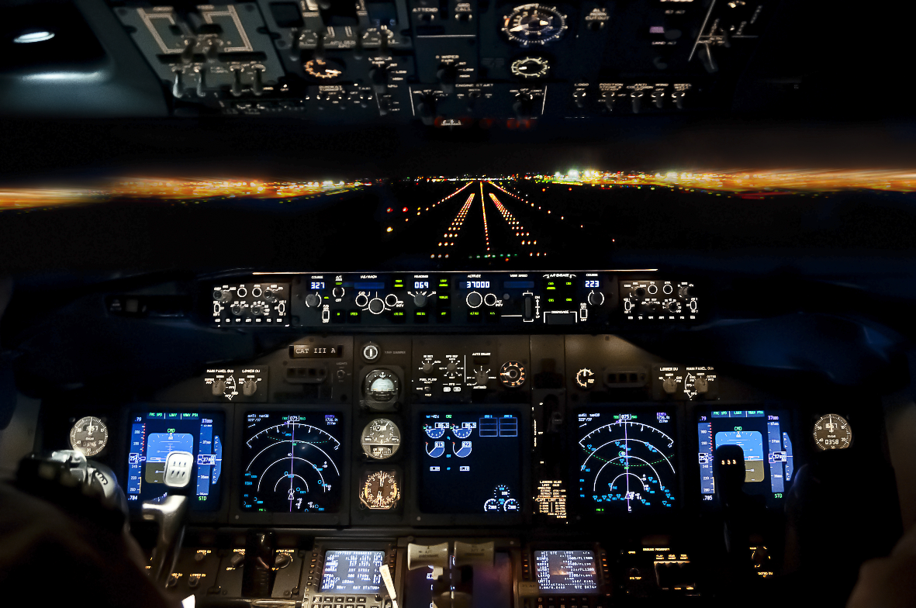

Background
The Media company of the CPG has the mandate to tag all media assets (mainly videos & pictures) so that these can be leveraged for business purposes such as marketing campaigns, promotional activities, content selection for the website, re-usability of media assets etc. The company currently has a team of individuals that manually tag each video. The company wanted to automate first line tagging to increase the number of assets that have basic tagging.
Smart Tagging
Improving the tagging’s team efficiency
Our Solution
A solution was developed to partially automate the tagging process. The solution primarily involved two engines: an image recognition label detector (formed by two APIs) and a filtering process (formed by a taxonomy-aligned filtering and a “topic” word embedding space). First, the label detector provides labels from every two seconds of the video; then a filtering is performed in two phases. First, misaligned taxonomy words are removed. Second, metadata from the video is leveraged to assess “most relevant words” via an word embedding space. The resulting labels are provided to the tagging team who accepts or rejects them.
Value Delivered
Previously, ~ 10% of the assets were tagged by the company. By automatically providing a basic tags for all media videos this has allowed time for the Media team to create high quality tags for selected videos. It had also increased the speed of high quality tagging for the company.
Click Here for More Details
For further information and enquires, please contact:
Tomas Meca
tmecafigueras@deloitte.co.uk
Tobias Hess
tobhess@deloitte.de
2

Slide 3

Further Detail on Services and Solutions

Slide 4
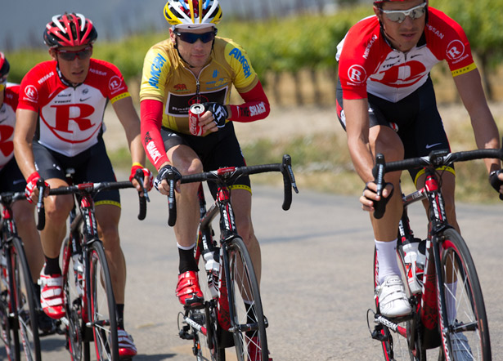
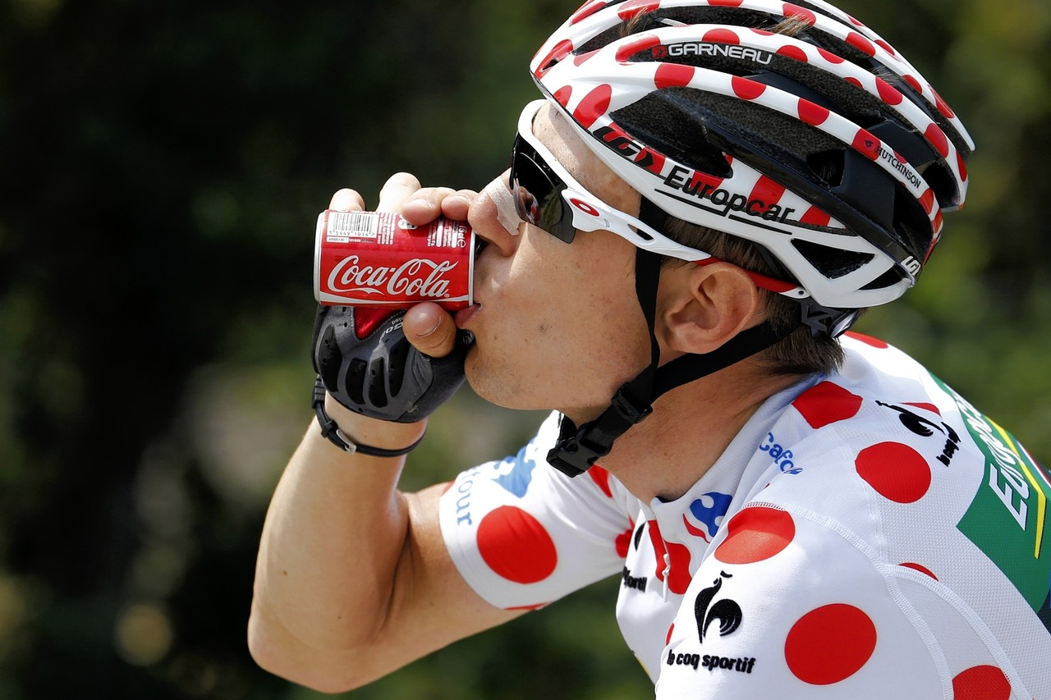
Can-in-Hand Recognition through CNN
Developing State-of-the-Art Models to Automate Media KPIs
Customised Logo & Can Detection Through Convolutional Neural Network
* Please note that these images are for demonstration purpose and does not represent our client

Slide 5


Smart Tagging
Improving the tagging’s team efficiency
Semantic Model
Cockpit
Rally
Building
Car
Police
Image Recognition APIs
Video
Compress and Split Frames
Receive Semantic Tags
Remove Irrelevant Tags
Consolidate and Count Tags
Select Top 40 Words by Count
Sort by Similarity to Video Topic
Provide Final Top 20 Results
Universe List
Taxonomy

